Slide 1
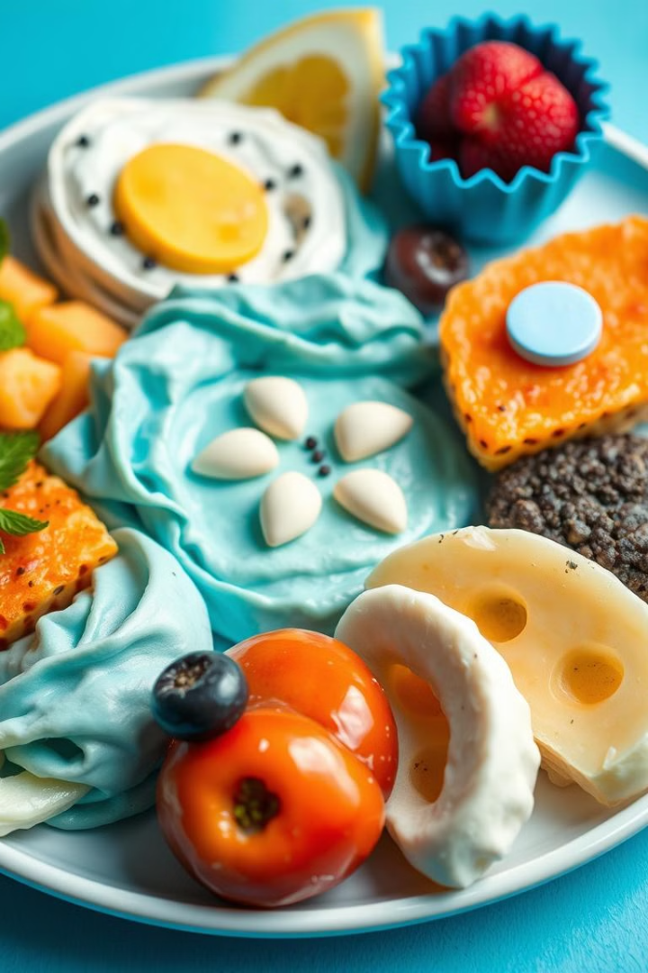
AI-Powered Food Description Generator
Automate restaurant menu descriptions with AI-generated text for engaging, friendly content. Attract customers and help chefs create new dishes.

Slide 2

Vision & Solution
1
Vision
2
Problem
3
Solution
Automate menu descriptions using AI.
Restaurants struggle with dish descriptions for customers and chefs.
AI generates descriptions with ingredients and images.

Slide 3
Agile Methodology
Product Owner
Scrum Master
Development Team
Stakeholders
Defines vision and prioritizes features.
Facilitates practices and removes roadblocks.
Builds and iterates on the AI system.
Restaurant owners, menu designers, customers.

Slide 4
Sprint Breakdown
Sprint 1
1
Requirement analysis & prototyping.
2
Sprint 2
Backend development & integration.
Sprint 3
3
Frontend & UX development.
4
Sprint 4
Image integration & performance optimization.
Sprint 5
5
Deployment & user feedback loop.

Slide 5




Technology Stack
Backend
Frontend
AI Model
Python, Flask.
HTML, CSS, JavaScript.
OpenAI API.

Slide 6

Challenges & Mitigations
Budget overruns
Set Budget Limit.
API latency issues
Implement caching and optimize calls.
Delay due to Out-of-scope
features
Clearly define project objectives.

Slide 7
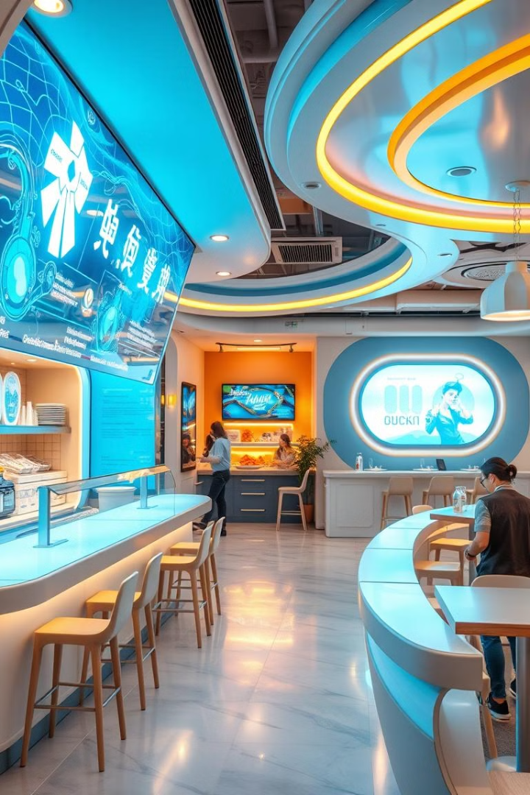




Future Enhancements
Multilingual Support
Global reach.
Voice-Based Generation
Hands-free descriptions.
POS Integration
Streamlined workflow.
AI Food Pairing
Smart recommendations.

Slide 8
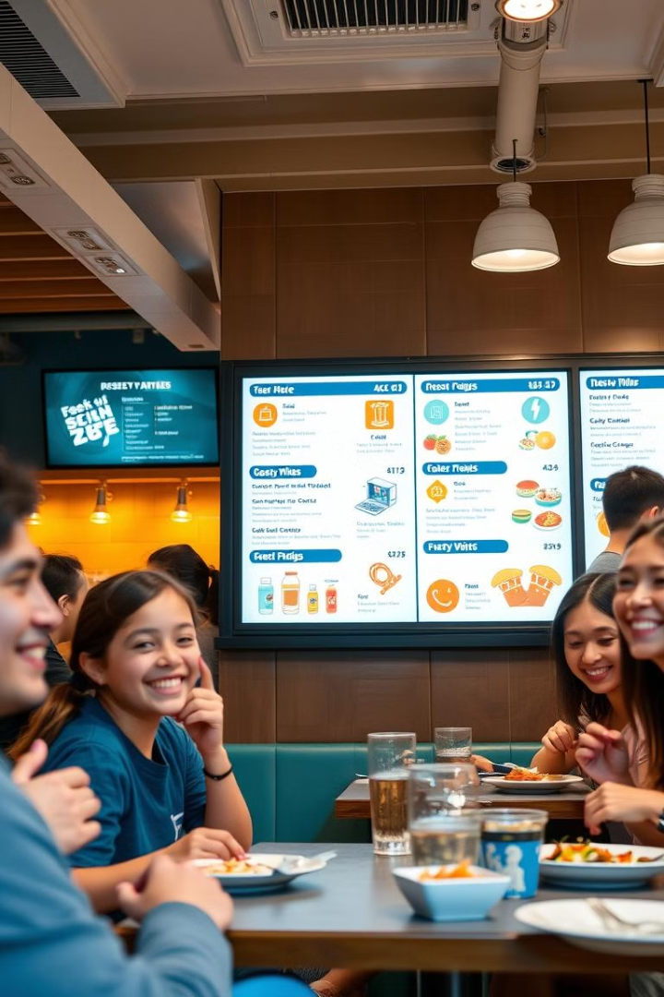
Conclusion
Revolutionize menu descriptions with a scalable, intelligent solution. Enhance customer engagement and boost sales. Automate your menu, attract more customers!

